Slide 1
presentation title

Slide 2
agenda
Project description and motivation
Major technical solutions compared
Project Demo
GitHub tour
Development journey (plan x actual experience)
Major challenges
Major accomplishments
Future plans (for us or someone else taking over)
Why buy our product?

Slide 3
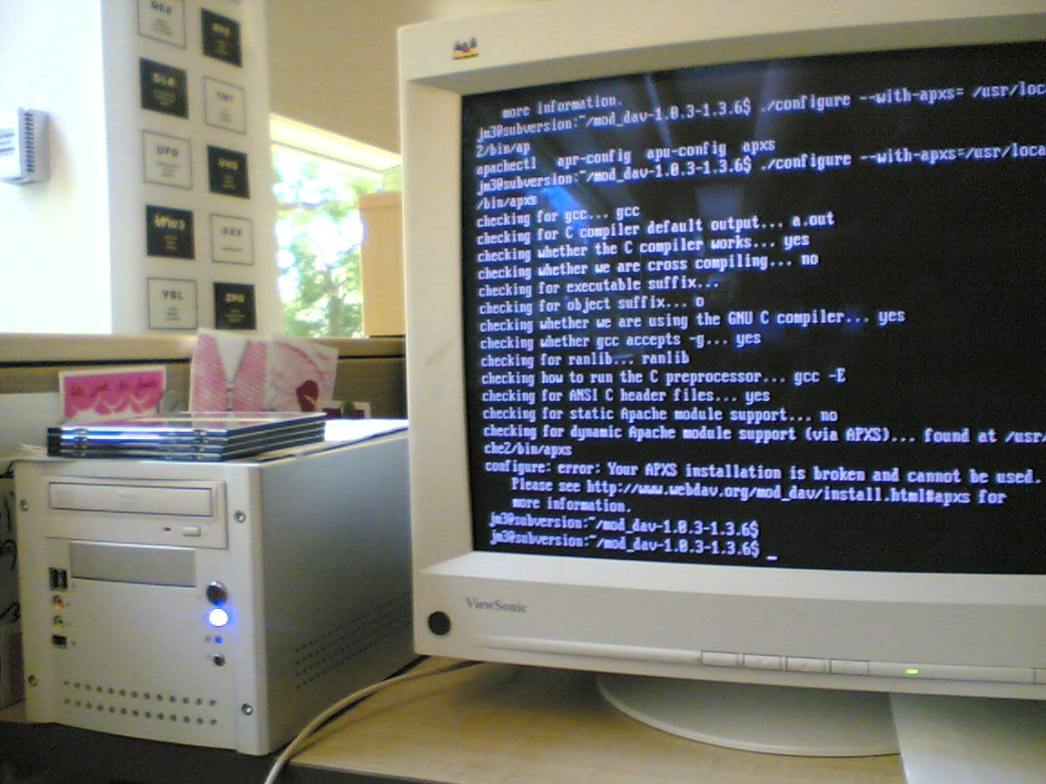
Project description and motivation

Slide 4

Major solutions compared

Slide 5
Major technical solutions compared
Abc
Def
Ghi

Slide 6
Project Demo

Slide 7
GitHub tour

Slide 8
Development journey
plan VS actual experience

Slide 9
Plan
Effective body language enhances your message, making it more impactful and memorable:
Meaningful eye contact
Purposeful gestures
Maintain good posture
Control your expressions
This is a powerful tool in public speaking. It involves varying pitch, tone, and volume to convey emotion, emphasize points, and maintain interest:
Pitch variation
Tone inflection
Volume control

Slide 10
Actual experience
Effective body language enhances your message, making it more impactful and memorable:
Meaningful eye contact
Purposeful gestures
Maintain good posture
Control your expressions
This is a powerful tool in public speaking. It involves varying pitch, tone, and volume to convey emotion, emphasize points, and maintain interest:
Pitch variation
Tone inflection
Volume control

Slide 11
Major challenges

Slide 12
Challenges
Know your material in advance
Anticipate common questions
Rehearse your responses
Maintaining composure during the Q&A session is essential for projecting confidence and authority. Consider the following tips for staying composed:
Stay calm
Actively listen
Pause and reflect
Maintain eye contact

Slide 13
Major accomplishments

Slide 14
speaking impact
Your ability to communicate effectively will leave a lasting impact on your audience
Effectively communicating involves not only delivering a message but also resonating with the experiences, values, and emotions of those listening

Slide 15
Future plans

Slide 16
final tips & takeaways
CONSISTENT REHEARSAL
Strengthen your familiarity
REFINE DELIVERY STYLE
Pacing, tone, and emphasis
TIMING AND TRANSITIONS
Aim for seamless, professional delivery
PRACTICE AUDIENCE
Enlist colleagues to listen & provide feedback
Seek feedback
Reflect on performance
Explore new techniques
Set personal goals
Iterate and adapt

Slide 17
Why buy our product?

Slide 18
speaking impact
Learn to infuse energy into your delivery to leave a lasting impression
One of the goals of effective communication is to motivate your audience
METRIC | MEASUREMENT | TARGET | ACTUAL
Audience attendance | # of attendees | 150 | 120
Engagement duration | Minutes | 60 | 75
Q&A interaction | # of questions | 10 | 15
Positive feedback | Percentage (%) | 90 | 95
Rate of information retention | Percentage (%) | 80 | 85

Slide 19
speaking engagement metrics
IMPACT FACTOR | MEASUREMENT | TARGET | ACHIEVED
Audience interaction | Percentage (%) | 85 | 88
Knowledge retention | Percentage (%) | 75 | 80
Post-presentation surveys | Average rating | 4.2 | 4.5
Referral rate | Percentage (%) | 10 | 12
Collaboration opportunities | # of opportunities | 8 | 10

Slide 20
thank you!

